Slide 1
Exploratory Data Analysis on Titanic Dataset
Presentation
By
Ronit Kumar
Name: Ronit Kumar
Domain: Data Science
Roll no:2312res541
Mail:ronit2312res541@iitp.ac.in

Slide 2
🚀 Project Objectives
This beginner-level EDA project aims to:
• Visualize survival counts
• Analyze survival based on gender and class
• Examine class distribution
• Explore age distribution

Slide 3
📁 Dataset
The dataset used is `titanic.csv` with the following columns:
• PassengerID
• Name
• Age
• Gender
• Class
• Survived

Slide 4
📊 Visualizations
This project includes the following visualizations:
• Countplot: Survived vs Not Survived
• Bar Plot: Survival by Gender and Class
• Pie Chart: Class Distribution
• Histogram: Age Distribution

Slide 5
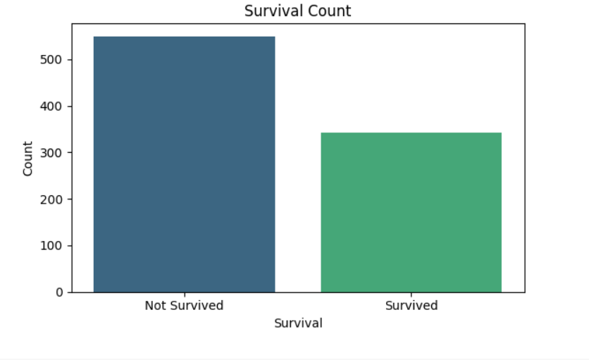
Survival Count
This is view of the survival count, reinforcing the stark difference in survival outcomes.

Slide 6
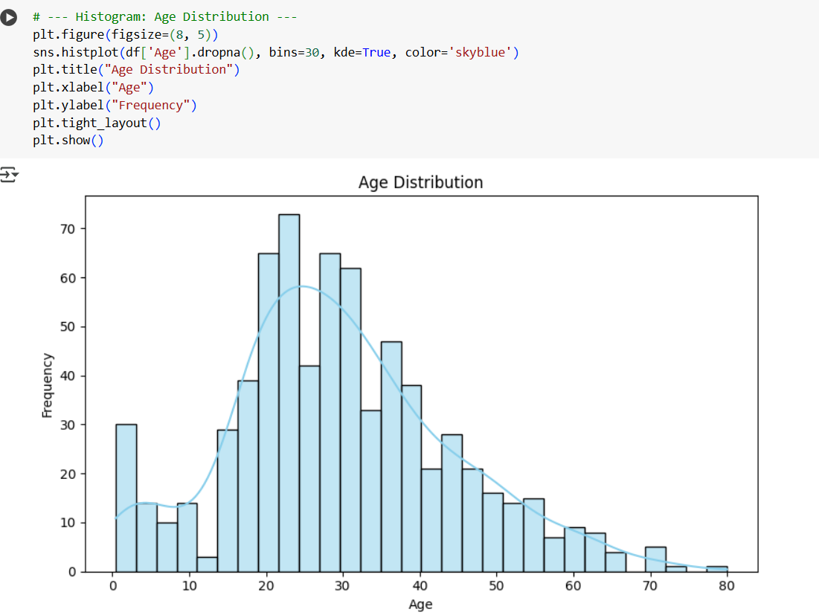
Age Distribution
The histogram visualizes the distribution of passengers' ages,
showing that most were between 20 and 40 years old, with a right-skewed distribution.

Slide 7
🛠️ Tech Stack & Setup
Libraries and tools used:
• pandas
• matplotlib
• seaborn
• Jupyter Notebook

Slide 8
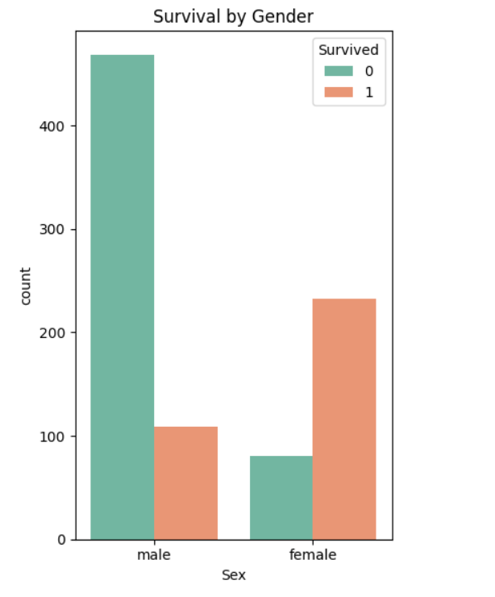
Survival by Gender
This grouped bar chart shows survival distribution across gender.
Female passengers had a much higher survival rate compared to males.

Slide 9
▶️ How to Run the Project
To run the EDA notebook:
1. Create virtual environment (optional): `python -m venv venv`
2. Activate the environment: `venv\Scripts\activate`
3. Install dependencies: `pip install -r requirements.txt`
4. Launch: `jupyter notebook Titanic_Eda.ipynb`

Slide 10
🙏 Thank You!
Questions and Feedback Welcome

